Slide 1
Development results of a PDE one-dimensional model to simulate thermal transfer from a heat source through to polyethylene and water.
Model Highlights:
A 48 by 12841 Matrix of PDE (partial differential equations) operators calculating a time series of one to three thermal cycles spanning 75 to 210 seconds and measuring across a one-dimensional span of 2.4 mm at .05 mm resolution.
The model simulates thermal block heat transfer to the vial and fluid.
Model Development Goals:
Develop a modeling tool that accurately simulates the thermal behavior of the “heated elements” of the Radium Thermal Cycler device. This is the polyethylene vial and the fluid contained in the vial.
Profile temperature within the polyethylene and vial fluid (at one-dimensional .05mm cross sections).
With the above measurement simulation capability, the model can be used to probe temperature regions that a thermistor can not reach.

Slide 2
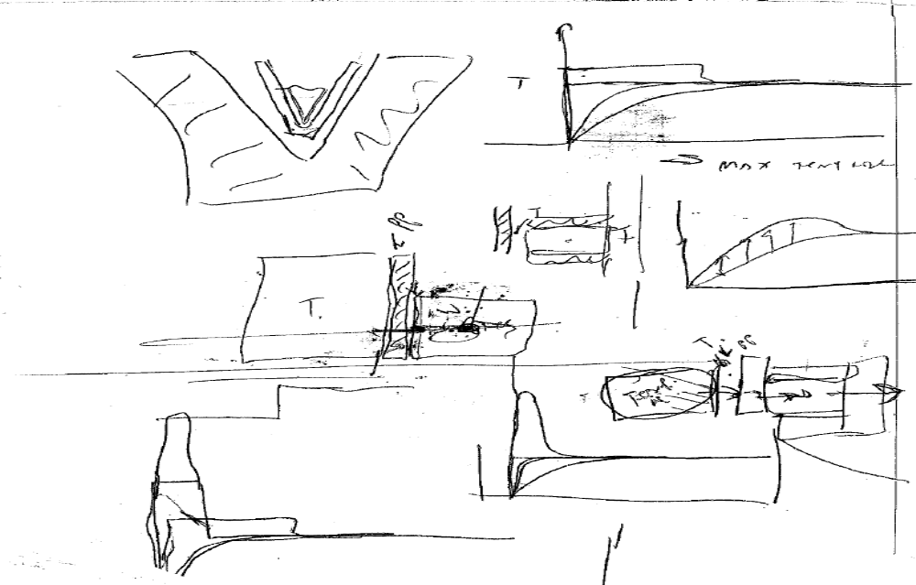
Original Project Notes

Slide 3
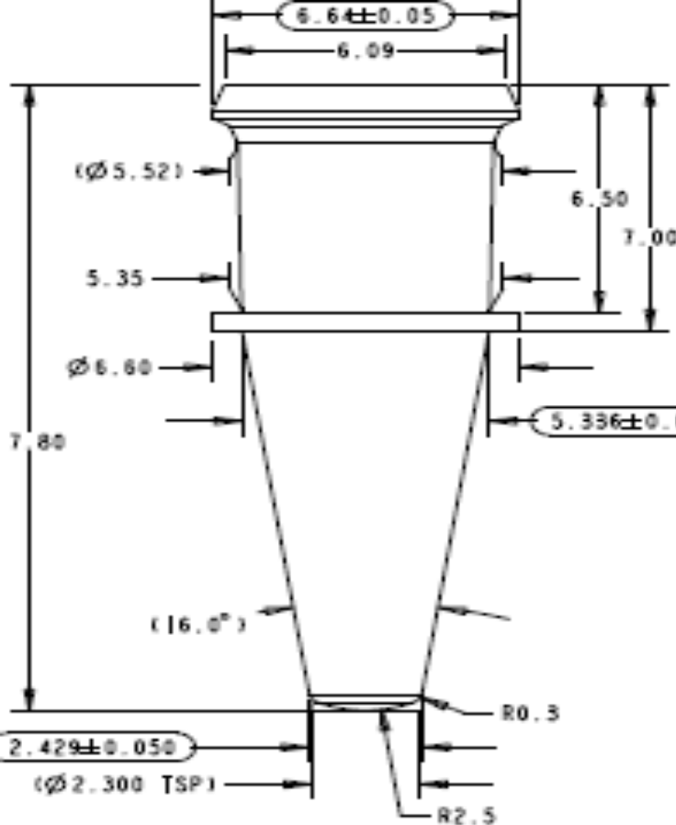
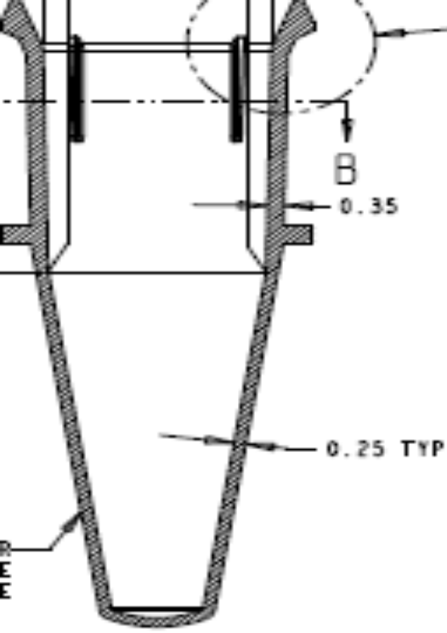
Vial Dimensions/Model Region of Interest.
1D Modeled Region in the Vial

Slide 4
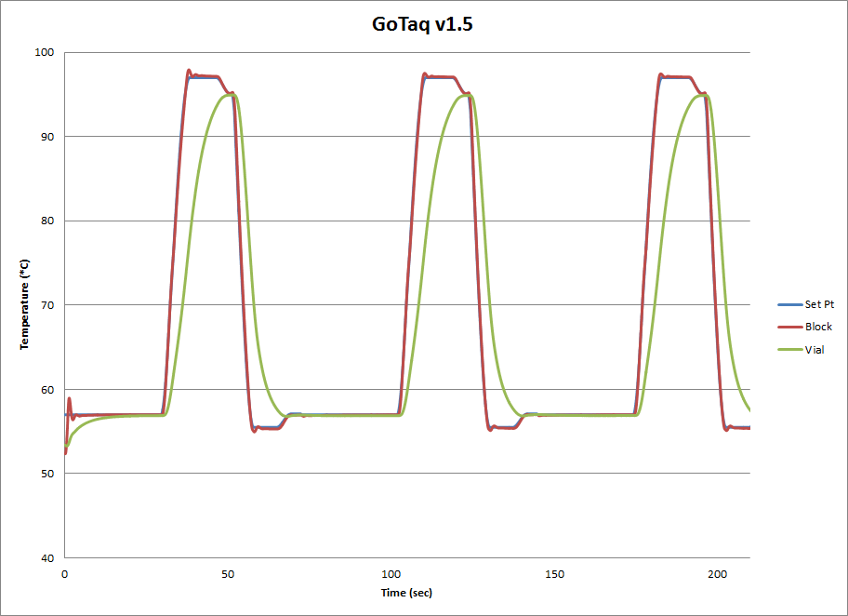
Live Thermal Data Captured from a Thermal Block and Vial
Notes:
Here we see live data captured from two measurement points. ( The edge of the thermal block and at a central point with the fluid contained in the vial.)

Slide 5
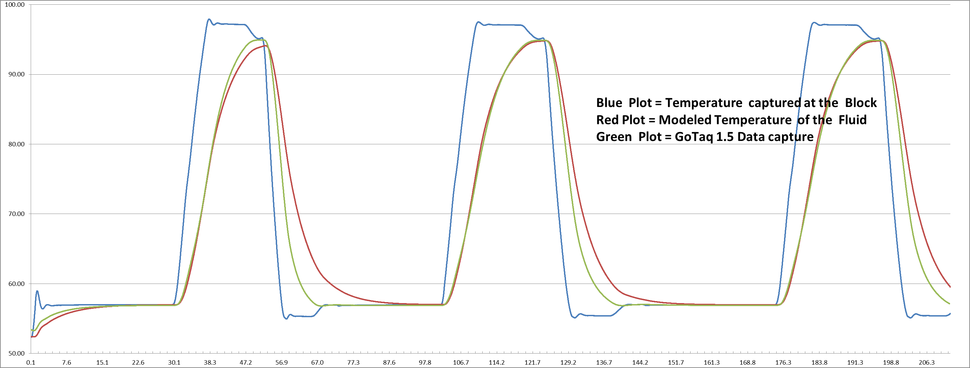
Comparing Simulated Thermal Data to Live Data
Errors in the model
Notes:
1. Shown is a “side by side” comparison of temperature data generated by the PDE model and GoTaq1.5 data.

Slide 6
Verification of the PDE Model
The model utilizes live data captured at the thermal block as an input.
The verification test is to measure differences between the model data output and live captured data.
Test Methodology:
Use a center point in the data field of the model for the data to be tested.
Import the GoTaq1.5 data captured in a vial.
Integrate the area under the curve for both live data and simulated.
Measure the variance of the simulated data to the measured data.

Slide 7
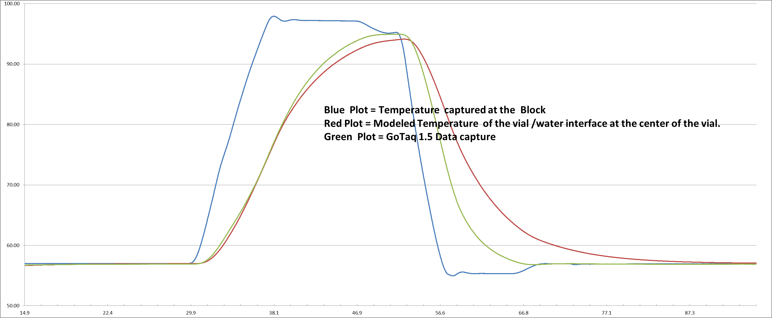
1st Cycle Data Plot of PDE Curve vs. The GoTaq1.5 Curve

Slide 8
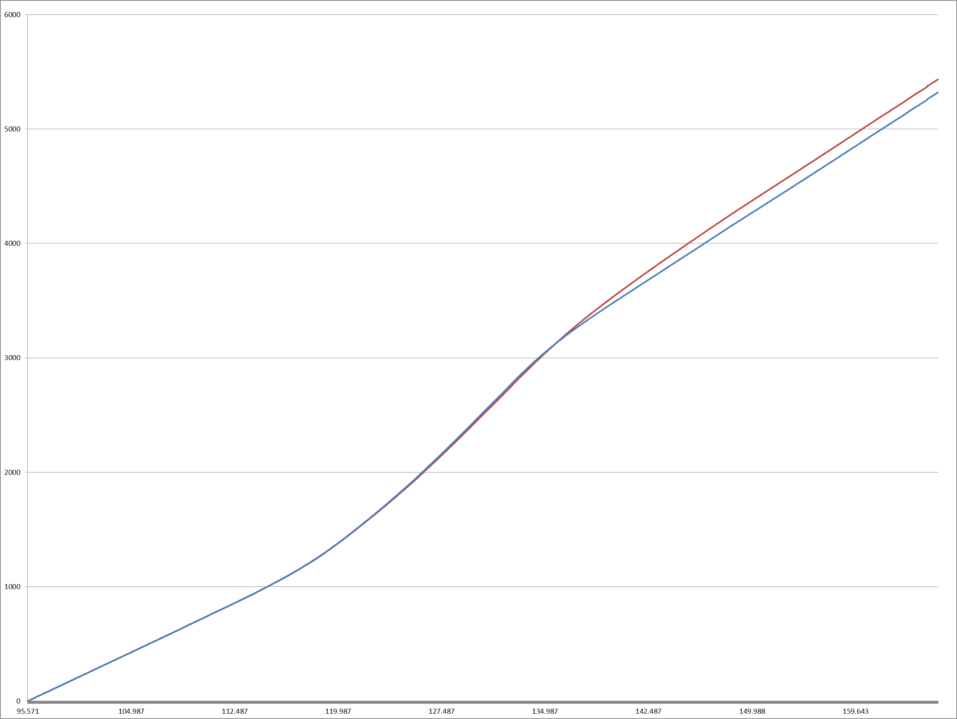
1st Cycle Integration Analysis. (The PDE curve has an overall error of 2%)
RED Line = Integration of PDE Curve
Blue Line = Integration of GoTaq1.5 Curve

Slide 9
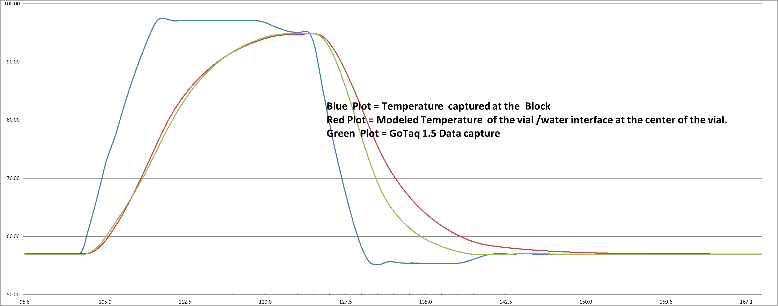
2nd Cycle Integration Analysis. (The PDE curve has an overall error of 2%)
Notes:
Here we see an up close capture of “real” data vs. simulated data on the second cycle of the data model.

Slide 10
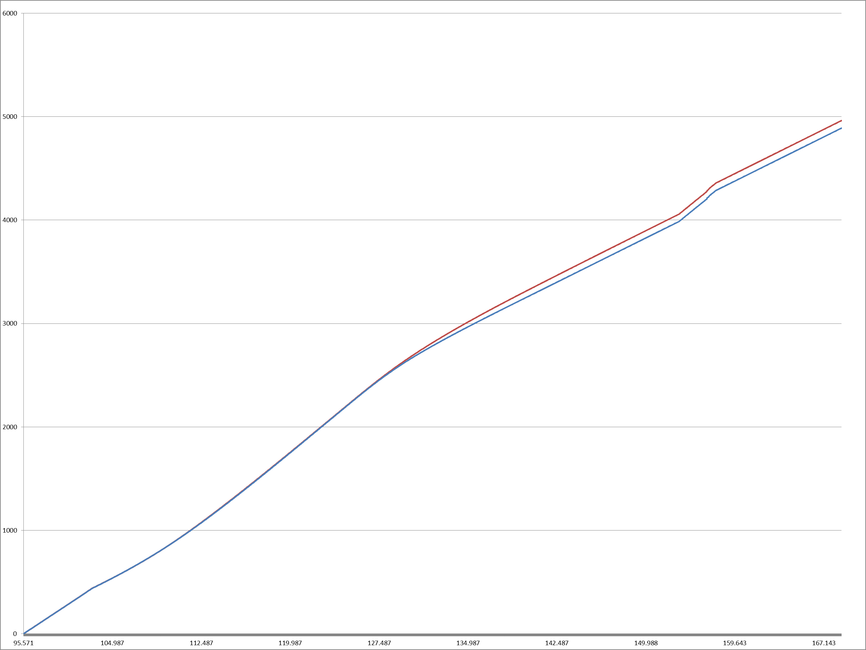
3rd Cycle Integration Analysis. (The PDE curve has an overall error of 1.5%)
RED Line = Integration of PDE Curve
Blue Line = Integration of GoTaq1.5 Curve

Slide 11
Summary of PDE Model Performance.
Based upon the current model, using the GoTaq 1.5 as a control input, it takes one thermal cycle for the PDE model to converge.
The accuracy of the model is better on the second cycle of the thermal control event.(This is due to model convergence.)
The second cycle PDE pulse “rise time” tracks the GoTag1.5 data very well.
The “fall time” of the PDE pulse is not as fast as the GoTag1.5 data.
Based upon the “area under the curve “ technique to measure the accuracy of the model, the first cycle is accurate to 2% and the second cycle accuracy is within 1.5% .

Slide 12
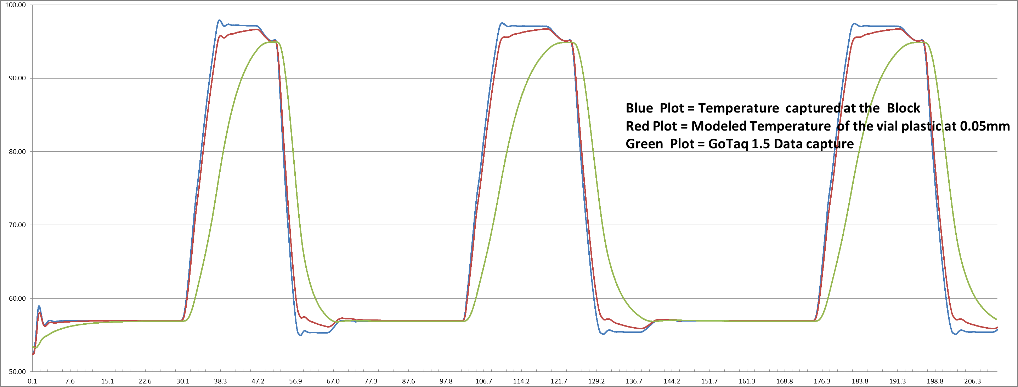
Simulated data at a 0.05mm boundary within the Vial Polyethylene

Slide 13
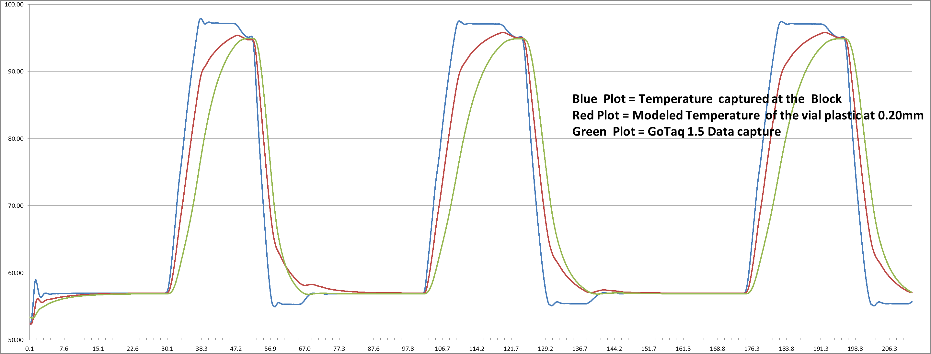
Simulated data at a 0.20mm boundary within the Vial Polyethylene

Slide 14
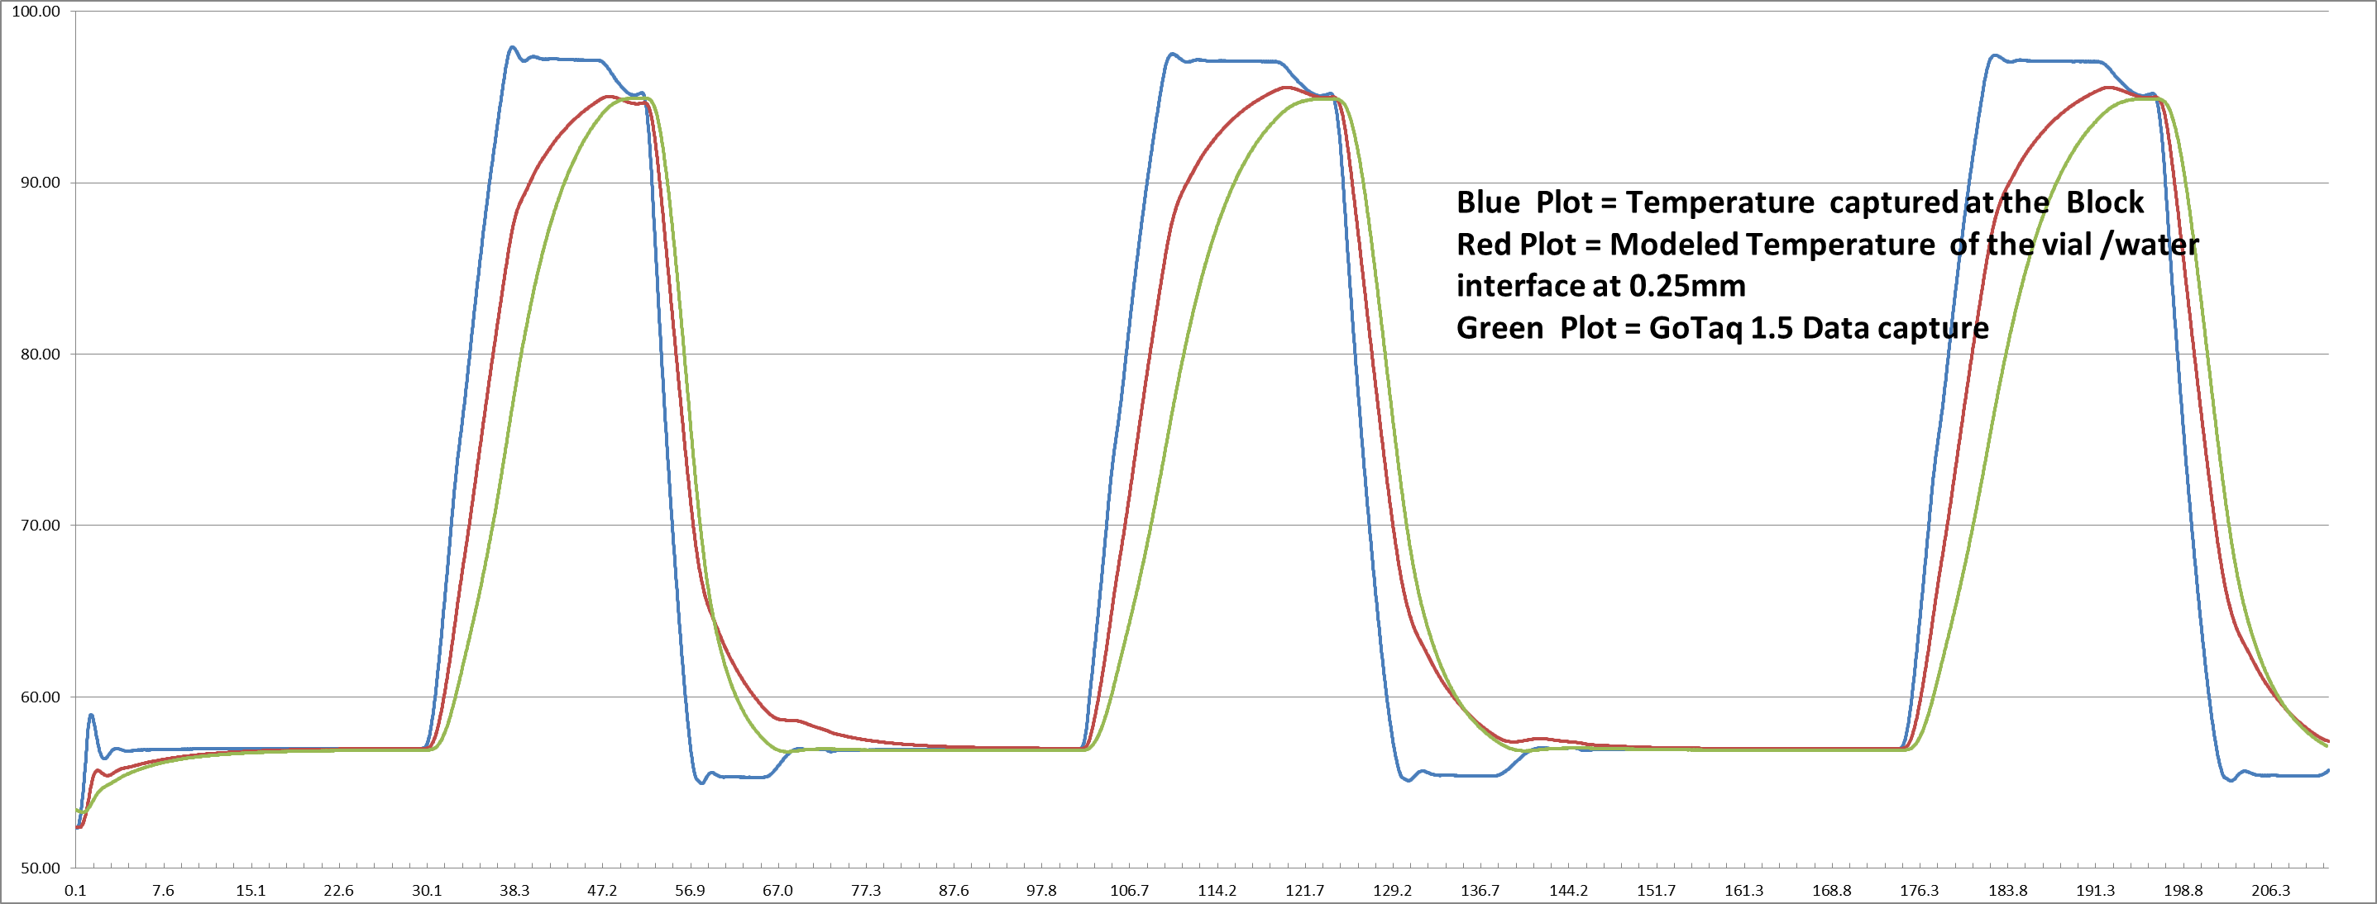
Simulated data at a 0.25mm boundary at the Vial and Water interface

Slide 15
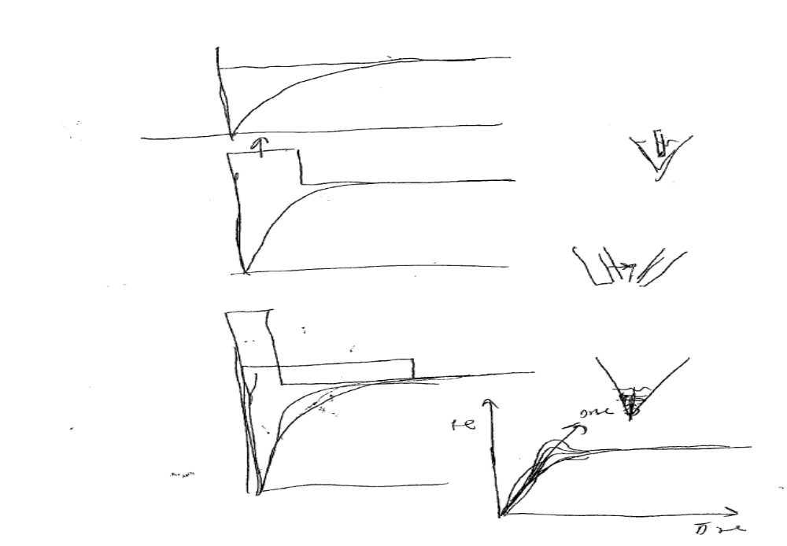
Synthetic Waveform/ Graph Notes and Goals.

Slide 16
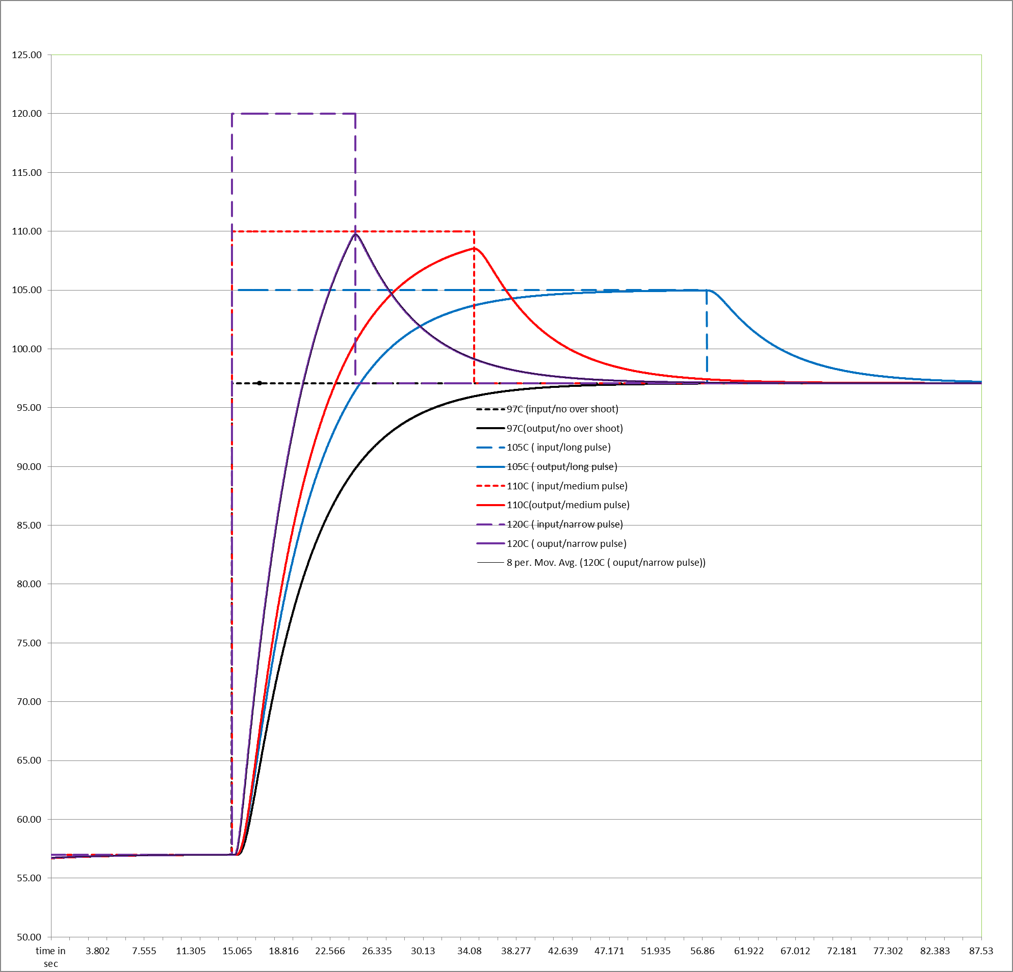
Comparing Thermal Input Waveforms/Shapes(One step function and 3 Pulses)

Slide 17
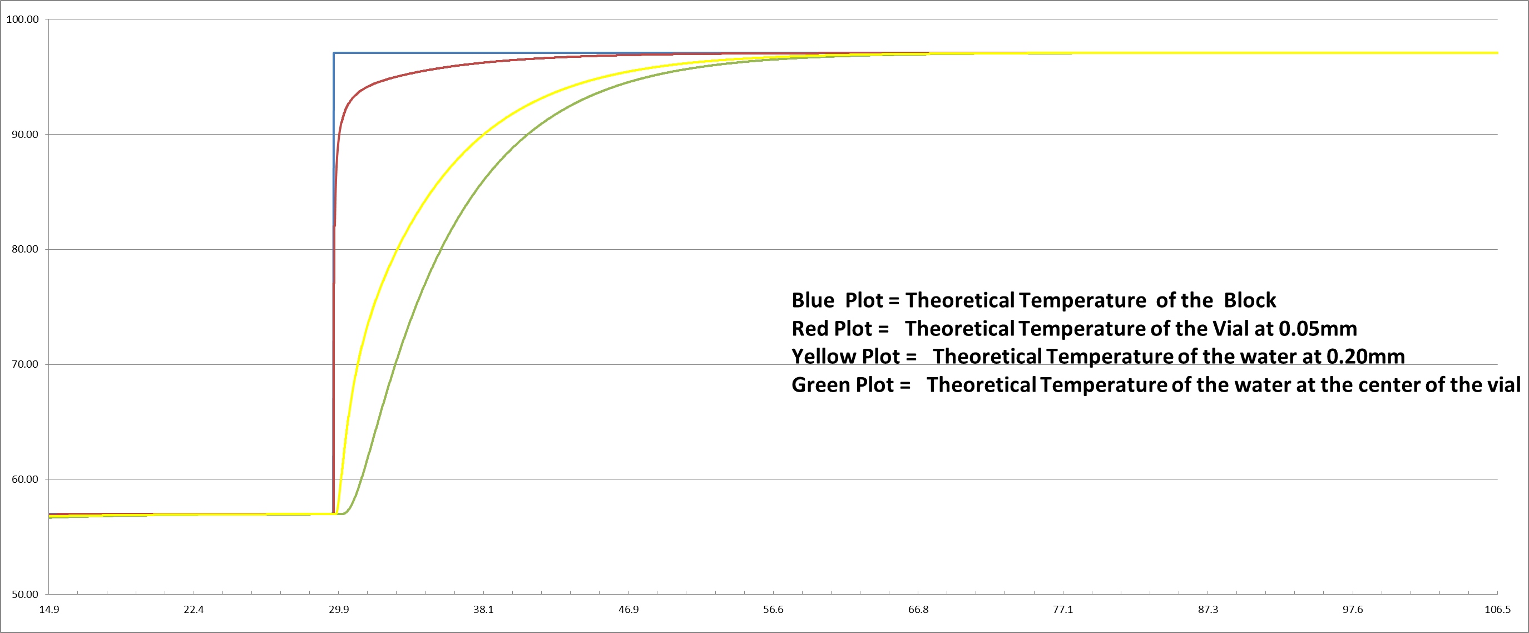
Step function Response at 97C

Slide 18
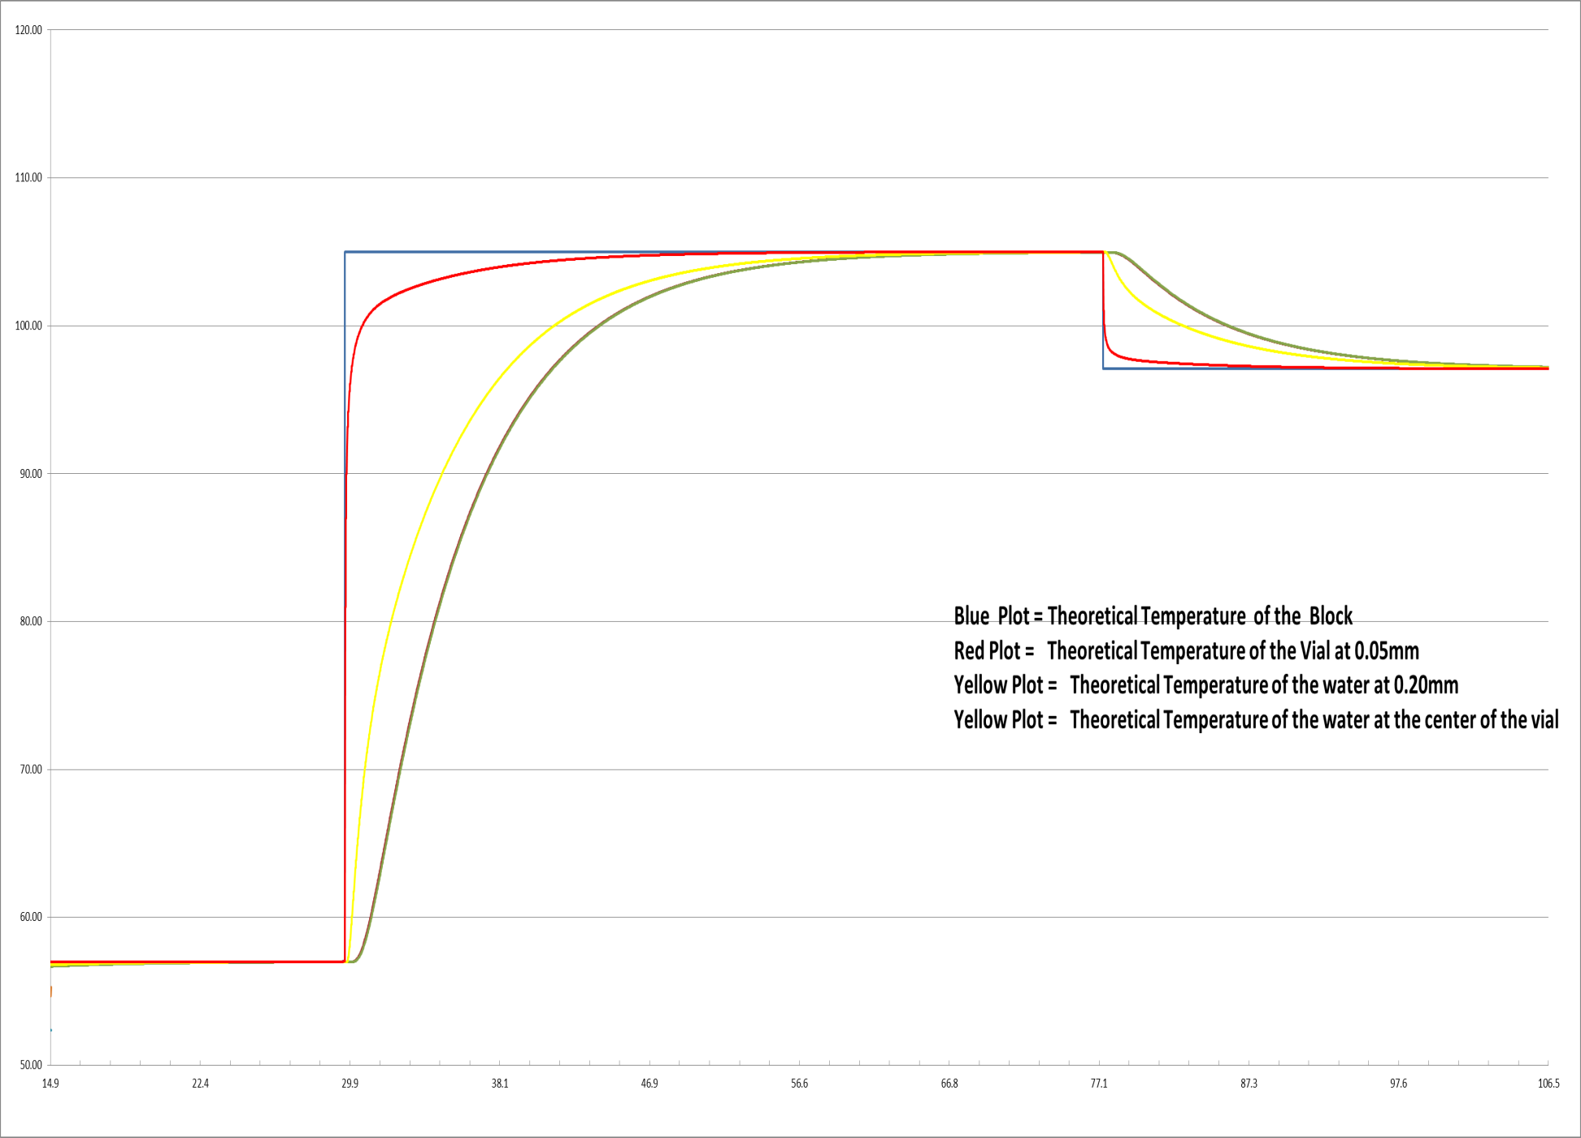
(40 seconds wide)Long Pulse at 97C

Slide 19
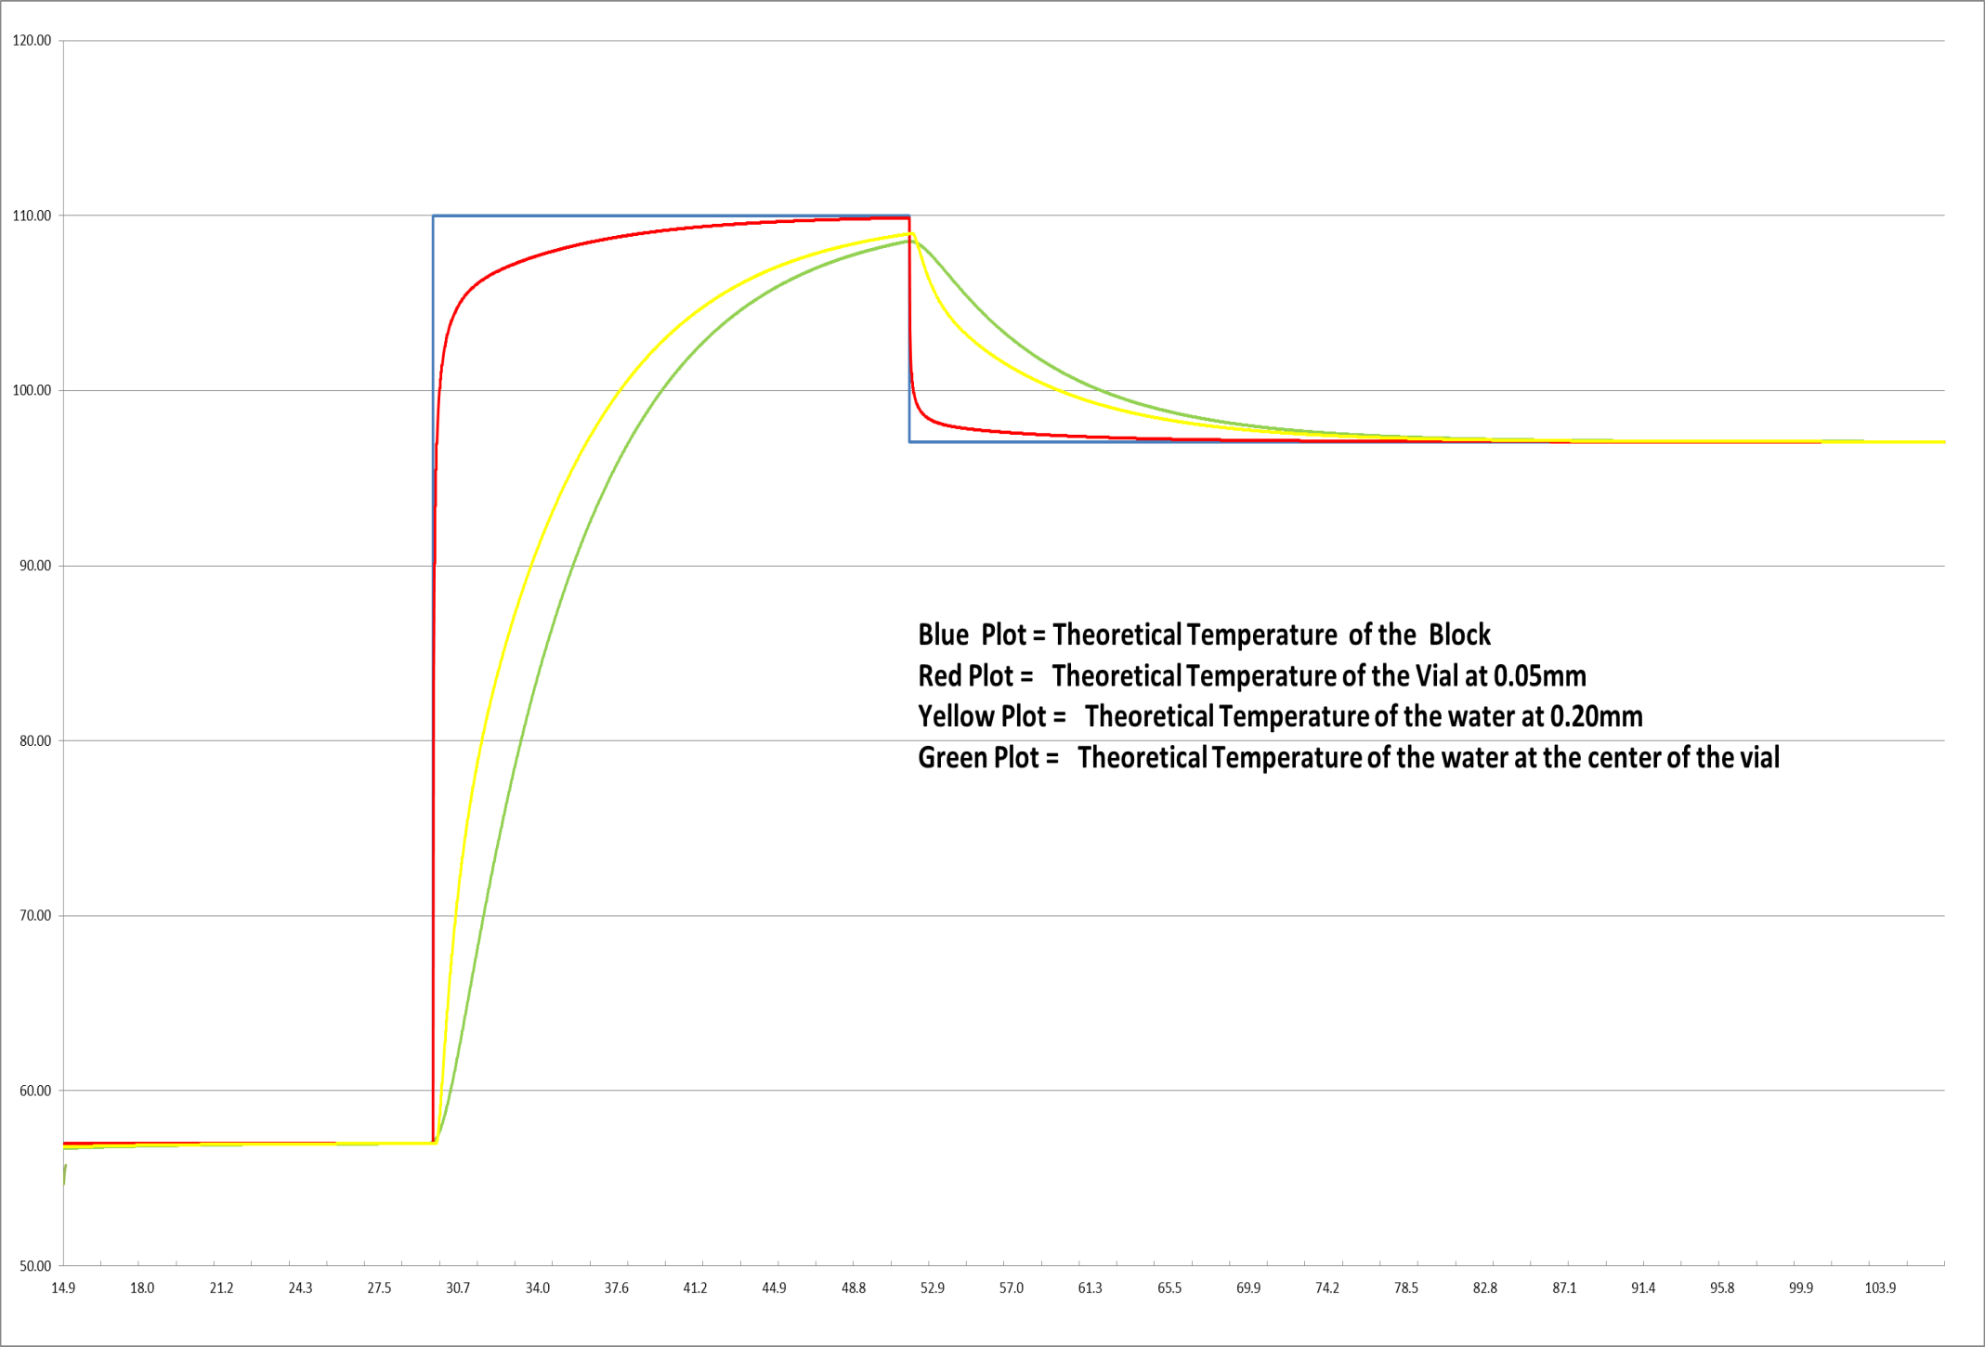
(20seconds wide) Medium Pulse at 100C

Slide 20
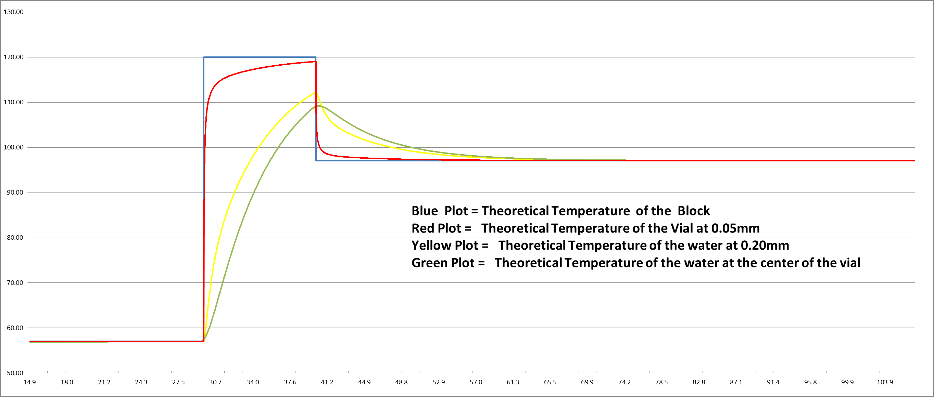
(10 seconds wide) Narrow Pulse at 120C

Slide 21
Summary of Model Observations.
Model convergence appears to be an issue with the 1D PDE approach.
Improvements to coefficients and boundary areas ,such as the air to Polyethylene and Polyethylene to water will improve model accuracy.
Further improvements can be achieved by adding a means to simulate the mounting of the thermistor in the vial with epoxy. (This would improve the fall time of the PDE curve at the center of the vial).
Based upon the “area under the curve “ technique to measure the accuracy of the model, the first cycle is accurate to 2% and the second cycle accuracy is within 1.5%.
There appears to be no thermal under shoot in the PDE model at probe positions close to the polyethylene. (This could be due to the accuracy of the falling edge of the PDE pulse.)
There are model thermal undershoots with in the polyethylene.
The model demonstrates response to thermal pulse input events consistent with thermal transfer theory.

